Slide 1
DuckDB 101
From 0 to 500 Million in < 1 sec
Brian Dill
www.briandill.net
www.linkedin.com/in/briandill
@bdill (Twitter/X)
@wbdill.bsky.social

Slide 2
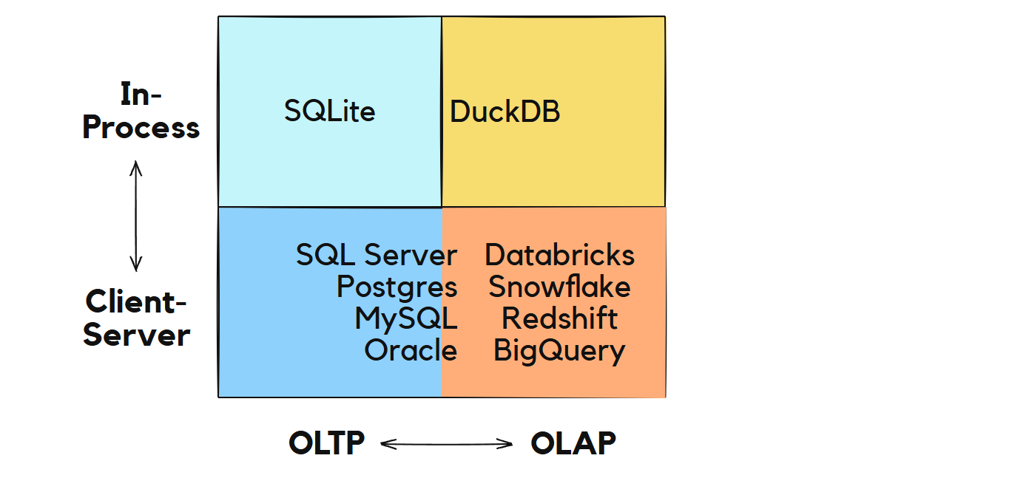

The Database Landscape

Slide 3
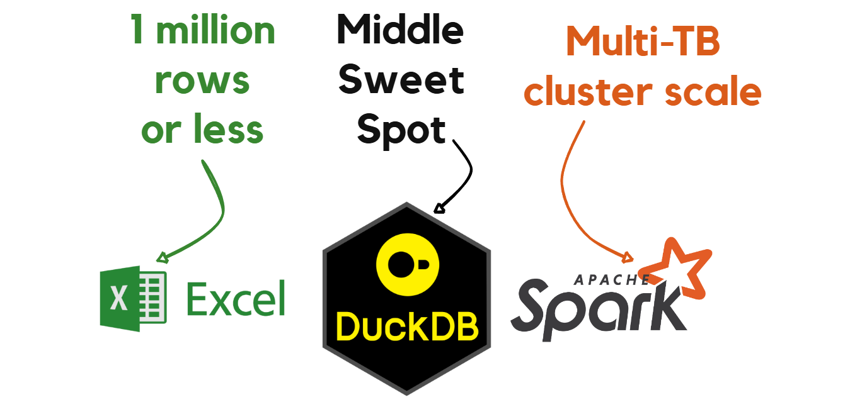
The Sweet Spot Middle

Slide 4
Pros and Cons
Pros:
FOSS
Lightweight (34MB)
Trivial Install
Built-in UI notebook
CSV & parquet 1st class
Handles data > RAM
Python/R friendly
ANSI SQL compliance
Blazingly fast (C++)
Cons:
No security model
Low concurrency (SQLite)
Single node only
No scheduling
Transactional, but not OLTP optimized
Limited dynamic SQL (use Python)
Smaller production track record
Neutral:
Columnar engine
Postgresql-style dialect
Analytic extensions

Slide 5
OLAP vs OLTP
Concept | OLTP | OLAP
Unit of Storage | Row | Column
Row are | Primary means of retrieval | An afterthought
Optimized for | Single row lookups Frequent writes and updates | Scans, Aggregations, Grouping
Speed from | Indexes (clustered and non-clustered) | Metadata (data skipping), vectorized access
M.O. | Finding a needle in a haystack | Describing the haystack

Slide 6
Demos in Three Acts
•Act I – Pure Speed
•Act II – Portable Utility
•Act III – Complete SQL Engine Capability

Slide 7

Act I – Pure Speed
Quick look at aggregating
over ½ billion rows

Slide 8

Act II – Portable Utility
Take the engine to the data
Query CSV files as if they are tables
Optionally persist CSV files as table
Perform basic SQL operations
filters
joins
select expressions

Slide 9

Act III – Complete SQL Engine
CTEs
Export CSV, parquet
Window functions
ROW_NUMBER, RANK, LEAD, LAG
Analytic Syntactic Sugar
omit SELECT *
GROUP BY ALL
SELECT * EXCEPT (col1, col2)
QUALIFY
SELECT filter - ex: COUNT(*) FILTER (WHERE … )

